Slide 1
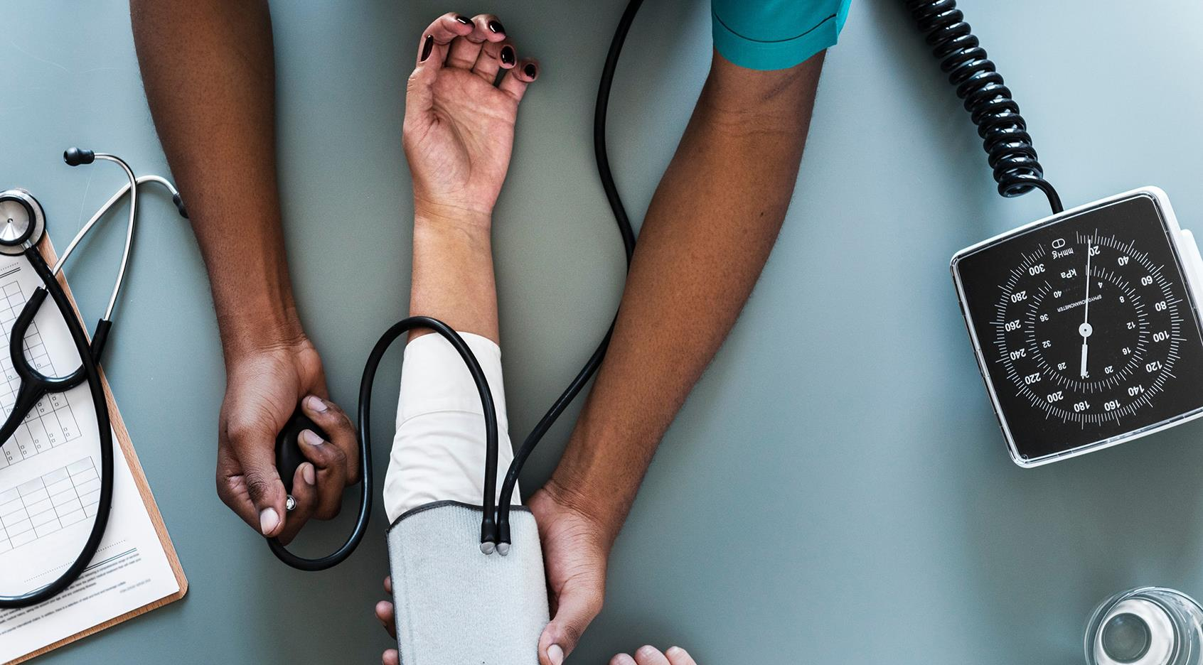

PHARMA
ESKİŞEHİR TECHNICAL UNIVERSITY
BİM437 SENIOR PROJECT

Slide 2
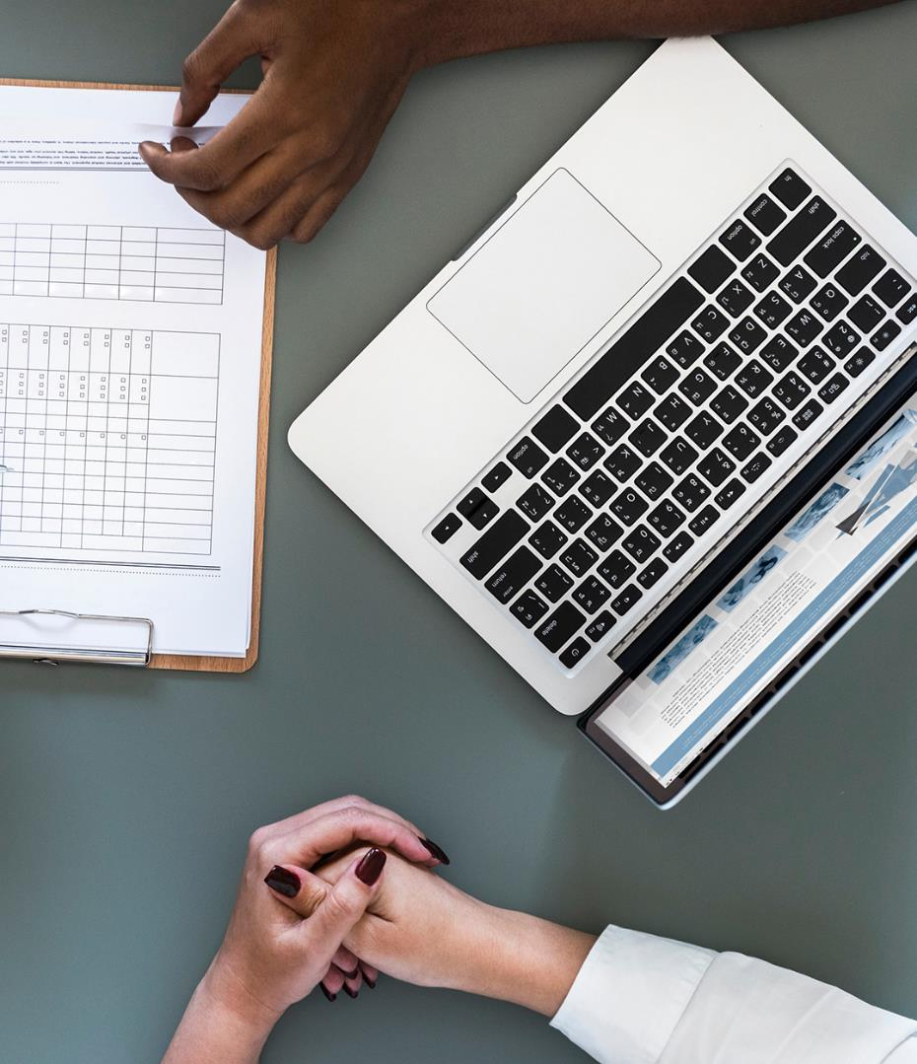
REVIEW OF PHARMA
The patients will be able to access to usage information of medicines.
Range
Usage Way
Dose
Max Usage Period
Our main aim is to inform the patients about the medicines they will use.

Slide 3
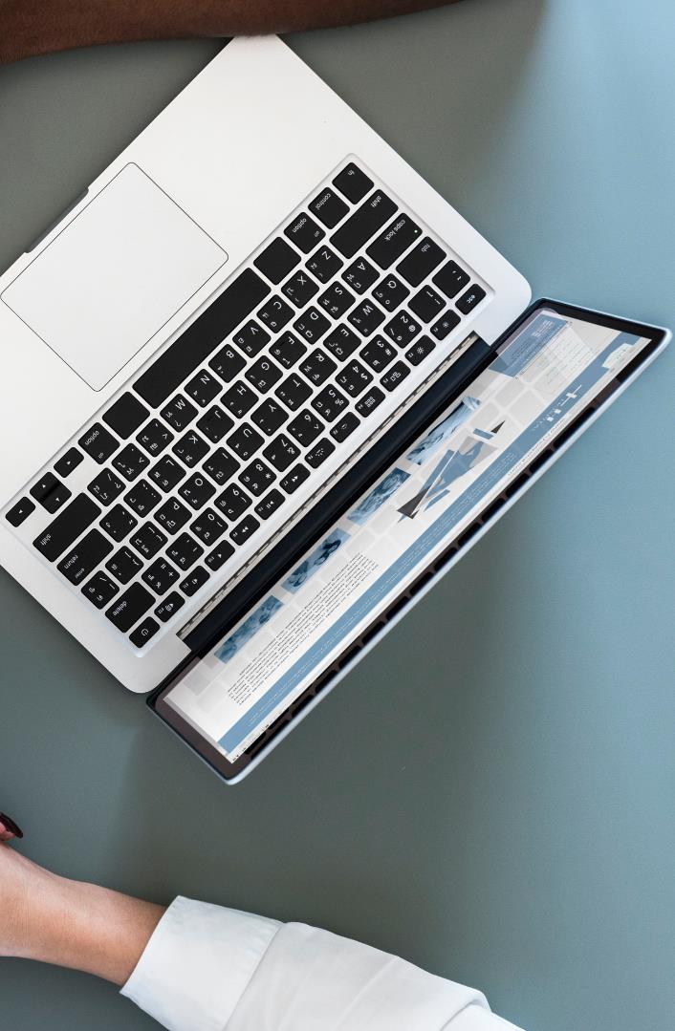
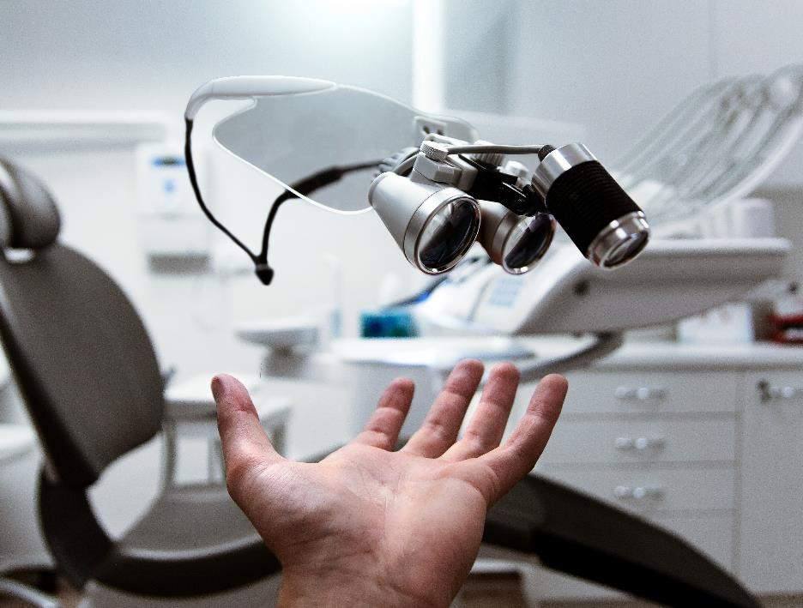
After doctors login, patients will scan own card then doctors will be able to see patients informations
And doctors will be able to prescribe to patients

Slide 4
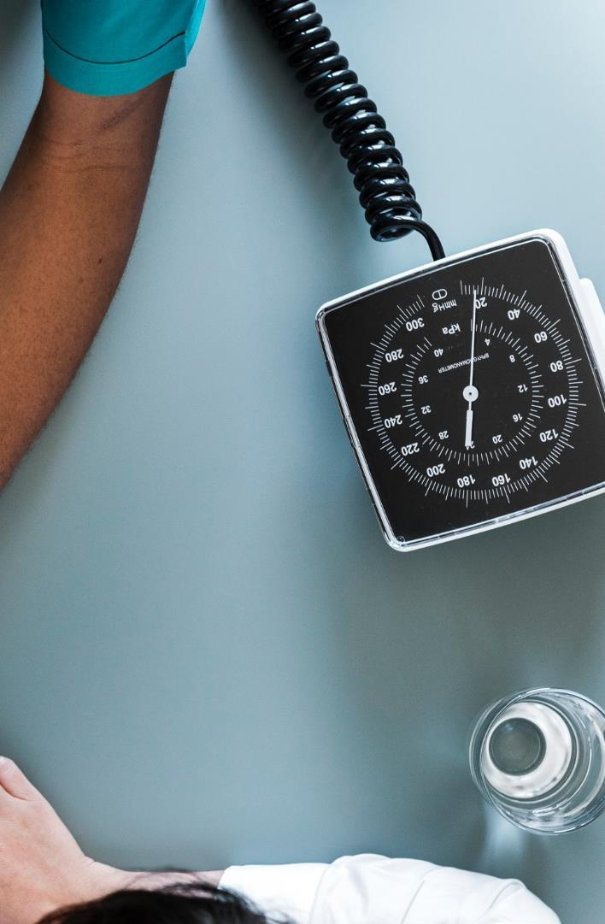



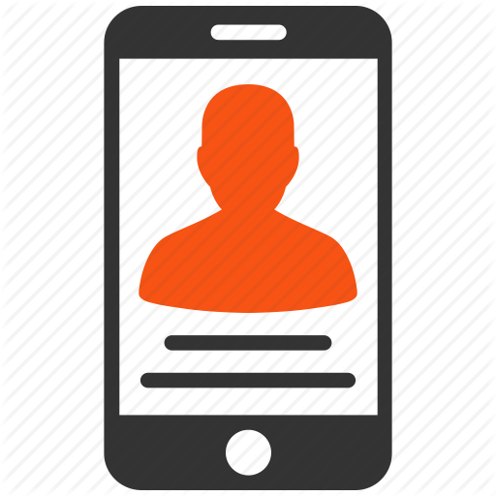
USERS
Admin Page
Doctor Page
Pharmacy Page
Patients Mobile App

Slide 5
TECHNOLOGIES
Arduino Uno
Microsoft Visual Studio
Microsoft SQL Server
Microsoft Azure SQL Database
Android Studio

Slide 6
Project Schedule
Our one semester plan
Research
Test - Deploy
Feb, 2019
May, 2019
JAN
FEB
MAR
APR
MAY
2019
Design
Programming
Feb, 2019
Mar,Apr, 2019

Slide 7

GOAL OF PROJECT
How to use the medicine of patients
When to use it
How often to use it with mobile application.

Slide 8
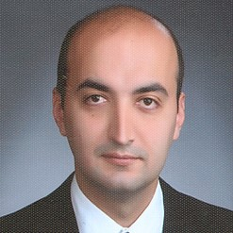
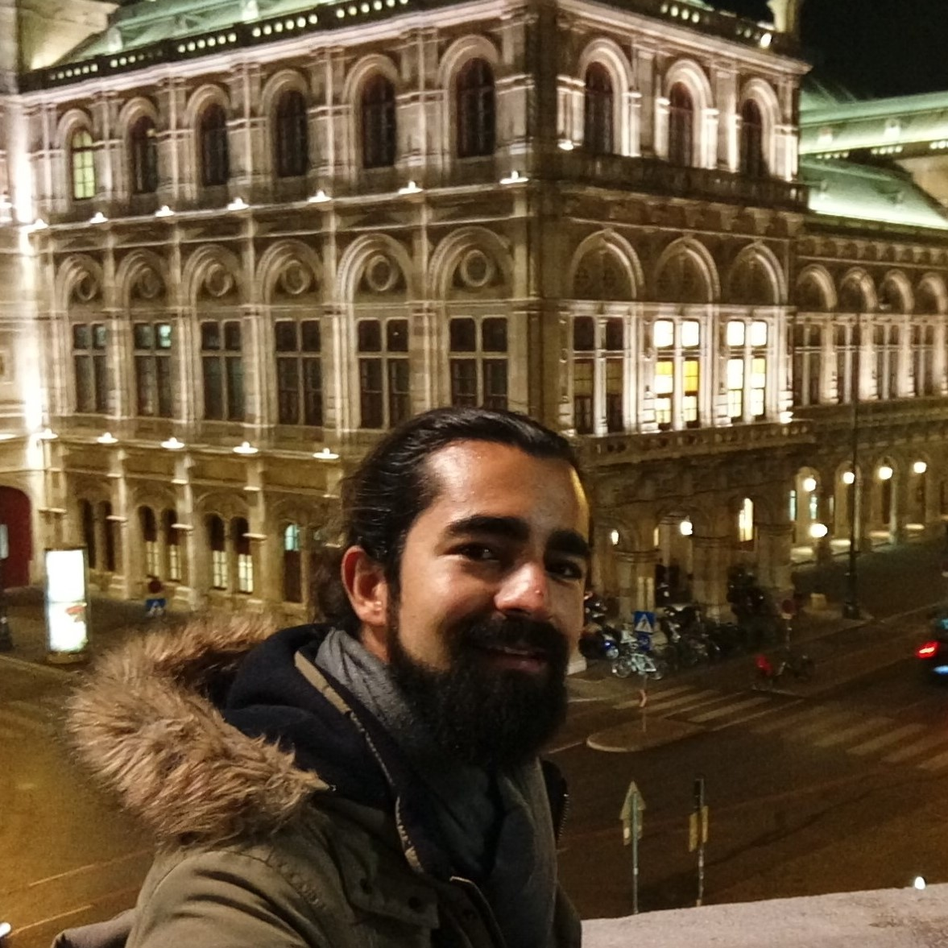
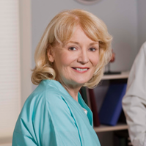
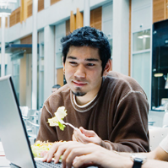
Team
Alper Kürşat Uysal
Özgür Hasan Aytar
Tuğba Öztürk
Gülşah Şahin

Slide 9


Thank You
Özgür Hasan Aytar
Gülşah Şahin
Tuğba Öztürk

